Slide 1

Supply Chain
Management
Supplier Relationship Management (SRM)

Slide 2

Discussion Outline
What is Supplier Relationship Management (SRM)
Keys to Successful Strategic Partnerships
Supplier Evaluation
Supplier Certification
Supplier Development
Supplier Recognition
Supplier Relationship Management Systems
Trends in Supplier Relationship Management

Slide 3
Discussion Outline
https://www.youtube.com/watch?v=LS08y9w6wYk
What is Supplier Relationship Management (SRM)
Keys to Successful Strategic Partnerships
Supplier Evaluation
Supplier Certification
Supplier Development
Supplier Recognition
Supplier Relationship Management Systems
Trends in Supplier Relationship Management

Slide 4
Supplier Relationship Management (SRM)
The discipline of strategically planning for, and managing, all interactions with the third party organizations that supply goods and/or services to an organization in order to maximize the value of those interactions.
Most supply professionals view SRM as an organized approach to defining what they need and want from a supplier.
Establishing and managing the company-to-company link to obtain those needs.
PROCUREMENT
Chapter 05
Chapter 06
Chapter 07
PURCHASING
MANAGEMENT
STRATEGIC
SOURCING
SUPPLIER RELATIONSHIP MANAGEMENT
Plan, Source, Make, Deliver / Return, and Enable

Slide 5

Supplier Relationship Management (SRM)
Identifying and measuring key strategic suppliers.
Improving profits and reducing costs using tools such as:
Sourcing Analytics
Sourcing Execution
Procurement Execution
Payment and Settlement
Supplier Score-carding
Performance Monitoring

Slide 6
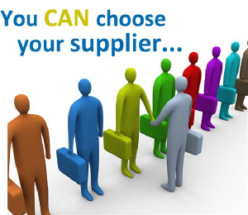
Supplier Relationship Management (SRM)
SRM is often a part of the rollout of Strategic Sourcing and is typically applied with suppliers:
Providing high volumes of a product/service
Providing lesser quantities of a crucial product/service
That serve many business units of a company or organization
Where intensive engineering, manufacturing and/or logistics interaction is essential.

Slide 7
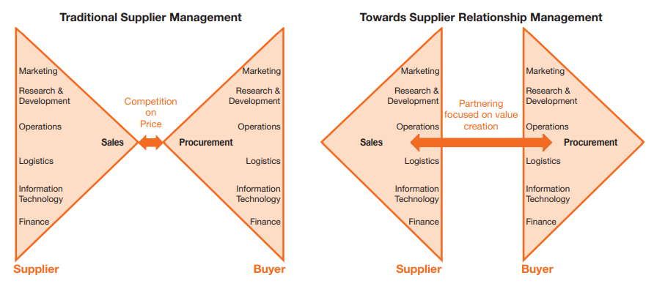
Supplier Relationship Management (SRM)
Traditional Supplier Management
Supplier Relationship Management

Slide 8
Discussion Outline
What is Supplier Relationship Management (SRM)
Keys to Successful Strategic Partnerships
Supplier Evaluation
Supplier Certification
Supplier Development
Supplier Recognition
Supplier Relationship Management Systems
Trends in Supplier Relationship Management

Slide 9
Successful Strategic Partnerships
Strong Supplier Partnerships
Important to achieving win-win competitive performance for the buyer and supplier
These require a strategic perspective as opposed to a tactical perspective.
Involves “a mutual commitment over an extended time to work together to the mutual benefit of both parties, sharing relevant information and the risks and rewards of the relationship”

Slide 10


Keys to Successful Strategic Partnerships
Building Trust
Trust is earned.
It is also easily lost, and almost impossible to regain once lost!
With trust, partners are more willing to work together, find compromise solutions to problems, work toward achieving long-term benefits for both parties, and go the extra mile.
Shared Vision and Objectives
Both partners must share the same vision and have objectives that are not only clear but mutually agreeable.
The focus must move beyond tactical issues and toward a more strategic path to corporate success.

Slide 11


Keys to Successful Strategic Partnerships
Personal Relationships
Strategic Partnerships begin with the development of personal relationships between key people at each company
It is people who communicate and make things happen
Mutual Benefits and Needs
Partnership should result in a win-win situation, which can only be achieved if both companies have compatible needs.
An alliance is much like a marriage, and if only one party is happy, then the marriage (i.e., alliance) is not likely to last

Slide 12


Keys to Successful Strategic Partnerships (continued)
Commitment and Top Management Support
Commitment must start at the highest management level.
Partnerships tend to be successful when top executives are actively supporting the partnership
Change Management
Companies must be prepared to manage change that comes with the formation of new partnerships

Slide 13


Keys to Successful Strategic Partnerships (continued)
Information Sharing and Lines of Communication
Both formal and informal lines of communication should be set up to facilitate the free flow of information.
Confidentiality of sensitive information must be maintained
Capabilities
Key suppliers must have the right technology and capabilities to meet cost, quality, and delivery requirements in a timely manner (current and future)

Slide 14
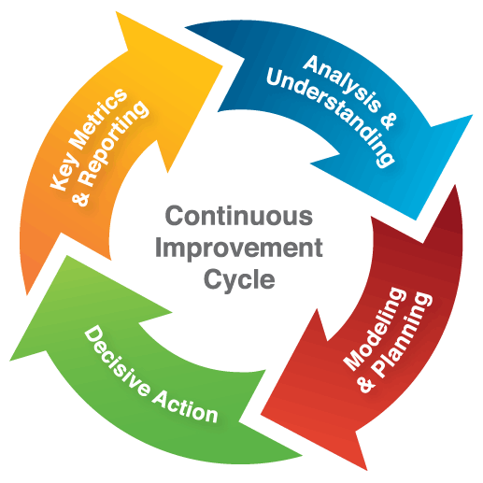
Keys to Successful Strategic Partnerships (continued)
Continuous Improvement
Making a series of small improvements over time results in the elimination of waste in a system
Buyers and suppliers must be willing to continuously improve their capabilities in meeting customer requirements

Slide 15
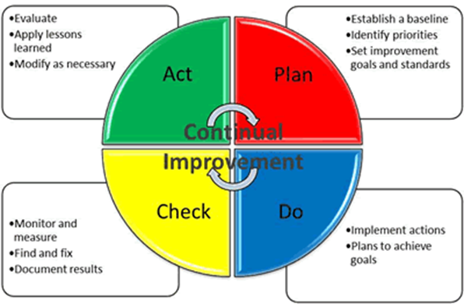
Keys to Successful Strategic Partnerships (continued)
The process commonly utilized in continuous improvement is; Plan, Do, Check, & Act
Plan: Identify an opportunity and plan for change.
Do: Implement the change on a small scale.
Check: Use data to analyze the results of the change and determine whether it made a difference.
Act: If the change was successful, implement it on a wider scale and continuously assess your results. If the change did not work, begin the cycle again.

Slide 16

Keys to Successful Strategic Partnerships (continued)
Performance Metrics
You can’t improve what you can’t (or don’t) measure
Measures related to quality, cost, delivery, and flexibility are used to evaluate suppliers.
Metrics should be: 1) understandable, 2) easy to measure, and 3) focused on real value-added results [S.M.A.R.T. objectives]
A multi-criteria approach is best [i.e., a SCORECARD]
Total Cost of Ownership, is made up of all costs associated with the acquisition, use, and maintenance of a good or service
S.M.A.R.T. = Specific, Measurable, Achievable, Relevant, Time-oriented

Slide 17
Benefits of Strategic Partnerships with Suppliers
Benefits for Buyers:
Preferred access to the supplier’s best people
Increased operating efficiencies
Lower costs
Improved quality
Enhanced service
Influence over supplier investments and technology
Preferred access to supplier ideas
Increased innovation from and with suppliers, leading to lower costs and incremental revenue
Sustainable competitive advantage
Benefits for Suppliers:
Greater visibility into buyer’s purchasing plans
Increased operating efficiencies
Longer term buyer commitments; greater predictability of future business
Increased scope of business and revenue
Lower cost of sales; increased margins
Opportunities to develop, pilot, and showcase innovative solutions
Sustainable competitive advantage

Slide 18
Discussion Outline
What is Supplier Relationship Management (SRM)
Keys to Successful Strategic Partnerships
Supplier Evaluation
Supplier Certification
Supplier Development
Supplier Recognition
Supplier Relationship Management Systems
Trends in Supplier Relationship Management

Slide 19

Supplier Evaluation
A process to identify the best and most reliable suppliers
Sourcing decisions are made on facts and not on perception (through the use of defined criteria)
Frequent feedback can help avoid surprises and maintain good relationships. (Hold regular review meetings)
Suppliers should be allowed to provide constructive feedback to the customer

Slide 20

Supplier Evaluation: Performance
It is important to actively monitor a supplier’s performance and provide visibility and feedback on supplier performance at each stage of the evaluation process.
Some relevant metrics include:
Supplier price and cost performance
Product receipt quality
Delivery performance
Financial stability
Contractual and standard compliance
Participation in product development
Cooperativeness in third-party production management
Support of both ethics and sustainable practices

Slide 21

Evaluating and Selecting Key Suppliers
When evaluating key suppliers for developing a collaborative relationship, purchase cost becomes relatively less important.
The assumption is that excellent suppliers will be able to drive costs out
“Squeezing” suppliers to generate a lower annual purchasing spend hurts strategic relationships! . . . but it is very often still done! [Profit Leverage Effect]
Key Supplier Selection is typically conducted by a cross functional team using evaluation forms or scorecards.
Weighting techniques are often used.

Slide 22
Supplier Evaluation: Weighted-Criteria
The Weighted-Criteria Evaluation System
Select the key dimensions of performance mutually acceptable to both buyer and supplier.
Monitor and collect performance data.
Assign weights to each of the dimensions.
Evaluate performance measures between 0 and 100.
Multiply dimension rating by weight and sum of overall score.
Classify suppliers based on their overall score, e.g., Certified, Preferred, Acceptable, Conditional, Developmental, Unacceptable, etc.
Audit and perform ongoing certification review.

Slide 23
Weighted-Criteria Evaluation System Example
Overall Supplier Rating
Overall Point Score:
Preferred: 90 to 100
Acceptable: 70 to 89
Developmental: 0 to 69
Delivery
OTIF
40%
Quality
40%
SCSS
20%
Number of SCARs
50%
Defects
PPM
50%
OTIF = On Time In Full
SCSS = Supplier Cost Savings Suggestions
SCAR = Supply Chain Action Report
PPM = Parts Per Million
Preferred: work with these suppliers in maintaining a competitive position and on new product development
Acceptable: require a plan from these suppliers outlining how they will achieve preferred status
Developmental: require corrective actions from these suppliers on how they will achieve acceptable level. Look for alternative suppliers if these do not achieve acceptability within a fixed period of time, e.g., 3 months.

Slide 24
Weighted-Criteria Evaluation System Example (cont.)
Supplier Scorecard Used for the XYZ Company
Performance Measure | Rating x Weight = Final Value
Quality Defects (PPM) | 90 | 0.25 | 22.50
Delivery OTIF | 85 | 0.20 | 17.00
Cost | 80 | 0.15 | 12.00
Responsiveness | 95 | 0.10 | 9.50
Innovation | 85 | 0.10 | 8.50
Corporate Social Responsibility | 90 | 0.10 | 9.00
Customer Complaints | 90 | 0.10 | 9.00
Total Score |  | 1.00 | 87.50

Slide 25
Discussion Outline
What is Supplier Relationship Management (SRM)
Keys to Successful Strategic Partnerships
Supplier Evaluation
Supplier Certification
Supplier Development
Supplier Recognition
Supplier Relationship Management Systems
Trends in Supplier Relationship Management

Slide 26
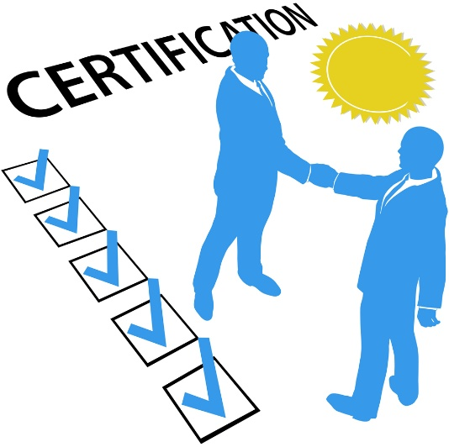
Supplier Certification Programs
One of the elements for building a strong strategic supplier partnership is having a well-defined and established Supplier Certification Program
A certified supplier is a source that through prior experience and qualification can provide material of such quality that it needs little if any receiving inspection or testing before going into approved stock or into the product process.
Administration of a Certified Supplier Program requires planning and long-term attention.

Slide 27
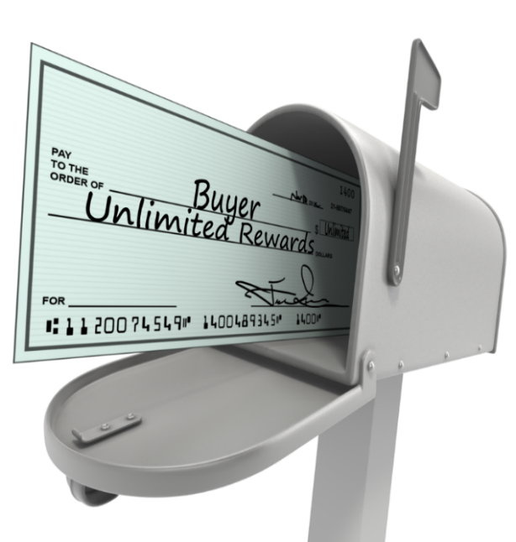
Benefits of Supplier Certification Programs
Reducing the amount of time and resources necessary for the buyer to conduct incoming inspections of products and materials from certified suppliers.
Buyer trains supplier on approved test methods so that supplier can test product before shipment, and provide a Certificate of Analysis (COA)
Buyers may then opt to only test items periodically on incoming inspection rather than with each delivery or lot, providing that the periodic testing confirms the supplier’s results.
Other Benefits of Supplier Certification
Building long-term relationships
Decreasing the supplier base
Certified suppliers are more reliable and therefore, you don’t need as may suppliers.
Recognizing excellence

Slide 28
Supplier Certification
Verification that a supplier operates, maintains, improves, and documents effective procedures that relate to the buyer’s requirements (e.g., cost, quality, delivery, flexibility, maintenance, safety, etc.)
Supplier certification programs are used to differentiate strategic supplier alliance candidates from others.
Companies may choose to develop internal certification programs, and/or require external certifications such as ISO 9000 and/or ISO 14000 as part of their overall certification process

Slide 29
Internal Certification Programs
Example of Criteria used for an internal Certification Program
Supplier has no incoming product rejections for a specified time period.
Supplier has no incoming late deliveries for a specified time period
Supplier has no significant negative quality related incidents for a specified time period
Supplier is ISO 9000 certified or has successfully passed a recent on-site quality system evaluation
Supplier consistently meets a mutually agreed-upon set of clearly specified quality performance measures
Supplier has a fully documented process and quality system with cost controls and continuous improvement capabilities
Supplier’s processes are determined to be stable and in control

Slide 30

External Certification
International Organization for Standardization (known as ISO) is the world’s largest developer of voluntary international standards.
Founded in 1947, today ISO has members from 163 countries and about 150 people working full time for the Central Secretariat in Geneva, Switzerland.
ISO certification is highly sought after as it represents achieving and maintaining a standard of excellence verified by an independent third party organization.
Benefits of ISO Certification:
Greater market potential
Compliance to procurement bids
Improved efficiency and cost savings
Higher level of customer service
Heightened staff moral and motivation

Slide 31
External Certification Program (continued)
Two ISO standards commonly used for supplier certification are:
ISO 9000
A series of management and quality standards in design, development, production, installation, and service.
Companies wanting to sell in the global market seek ISO 9000 certification.
ISO 14000
A family of standards for environmental management.
The benefits include reduced energy consumption, environmental liability, waste and pollution, and improved community goodwill.
There are more than 21,000 ISO standards, however, ISO 9000 and ISO 14000 are by far the most widely used and can be applicable to any type of business.

Slide 32
ISO 9000
There are eight (8) quality management principles on which the ISO 9000 series quality management system standards are based:
Customer focus – understand current and future customer needs
Leadership – establish unity of purpose and direction of the organization
Involvement of people – people are the essence of an organization
Process approach – a desired result is achieved through a managed process
Systems approach to management – managing interrelated processes
Continual improvement – performance improvement is a permanent objective
Factual approach to decision making – decision are based on facts and data
Mutually beneficial supplier relationship – interdependent benefits create value for both an organization and its suppliers.

Slide 33
External Certification
ISO certified suppliers are preferred by procurement departments because . . .
They have to conform to an externally defined set of standards for quality and delivery of service
They are usually more open to sharing supply chain information
They welcome building relationships with their customers
They have formal processes in place for continuous improvement of their products, services, and processes
They are easier for procurement to initially qualify and periodically audit
Certification is done by an independent third party agency
Firms have to be re-certified every three years

Slide 34
Discussion Outline
What is Supplier Relationship Management (SRM)
Keys to Successful Strategic Partnerships
Supplier Evaluation
Supplier Certification
Supplier Development
Supplier Recognition
Supplier Relationship Management Systems
Trends in Supplier Relationship Management

Slide 35
Supplier Development
Supplier development is the technical and financial assistance given to existing and potential suppliers to improve quality and/or delivery performance.
In simpler terms, it can be described as a buyer’s activities to improve a supplier’s capabilities.
A supplier’s knowledge and the technology that they use to produce the commodity they supply, can be leveraged through supplier development.
Supplier development programs should be designed to achieve:
Lower supply chain total cost
Increased profitability for all supply chain participants
Increased product quality
Near-perfect on-time-delivery at each point in the supply chain

Slide 36
Supplier Development
A supplier development program must be aimed at improving suppliers performance, not bullying them into charging less or simply auditing and rewarding them.
Supplier development is all about providing suppliers with what they need to be successful in the supply chain.
Two of the most important functions of a supplier development program are:
Providing information about products, expected sales growth, etc. Suppliers need to become extensions of their customers.
Training suppliers in the application of lean and six sigma / quality tools.
Asking suppliers to lower their price without giving them the knowledge on how to lower their costs is not sustainable in the long-term.

Slide 37

Supplier Development: Process Steps
The typical approach to supplier development is based on the following process steps:
Identify critical products and services
Identify critical suppliers of those products and services
Form a cross-functional team internally to work with the supplier
Meet with the top management at the supplier to get their support and involvement
Identify key development needs and projects
Define details of the agreement and the action plan
Monitor the status of the projects / action plan and modify strategies as necessary
With a robust supplier development program, companies can establish trust through a heightened commitment to their supply partners.

Slide 38
Tapping into Strategic Supplier’s Knowledge
Strategic Sourcing partners offer the opportunity for a company to extend their intellectual capabilities by involving their external partner base in product development.
Early Supplier Involvement (ESI) - Key suppliers become more involved in the internal operations of the buyer’s company, particularly with respect to new product and process design, concurrent engineering, and design for manufacturability.
Strategic Suppliers are asked to add their knowledge and expertise to the company’s new product development process.
Value Engineering activities help the buyer’s company to reduce cost, improve quality and reduce new product development time beginning with the initial design

Slide 39
Discussion Outline
What is Supplier Relationship Management (SRM)
Keys to Successful Strategic Partnerships
Supplier Evaluation
Supplier Certification
Supplier Development
Supplier Recognition
Supplier Relationship Management Systems
Trends in Supplier Relationship Management

Slide 40

Supplier Recognition Programs
A program to recognize suppliers who achieve the high performance standards necessary to meet customer expectations.
The success of the business can depend on the quality and performance of the company’s suppliers.
It is always a good practice for a company to have innovative supplier recognition programs in order to recognize their achievements and reward them for their exceptional performance and services.

Slide 41
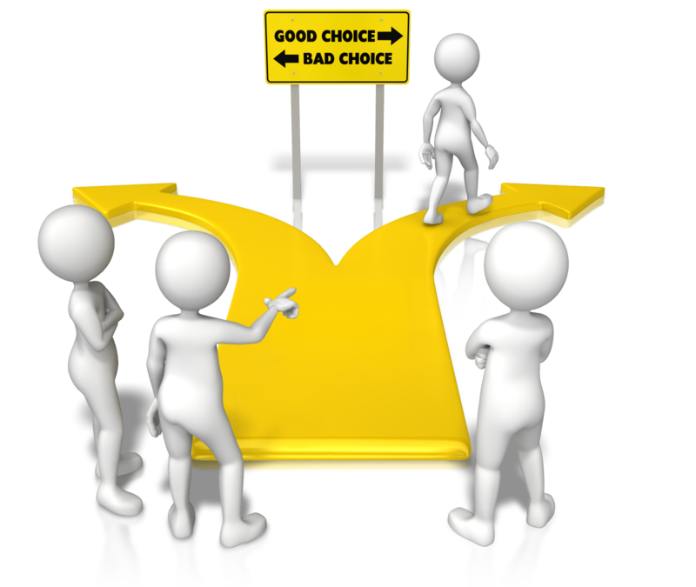
Supplier Recognition Programs
Three Attributes:
Companies should recognize and celebrate the achievements of their best suppliers.
Award winners exemplify true partnerships, continuous improvement, organizational commitment, and excellence.
Award-winning suppliers serve as role models for other suppliers.

Slide 42
Benefits of Supplier Recognition Programs
There are several key benefits of Supplier Recognition Programs that make them valuable for a business organization.
Motivate Suppliers - Can motivate suppliers to excel in terms of their quality, pricing and delivery commitments.
Improve Supplier Loyalty - Supplier support is important to ensure that customer delivery commitments are maintained.
Encourage Suppliers to Adapt to the Company’s Culture - If the company treats its suppliers as a part of the family and engages in supplier recognition programs periodically, it can help to bring the suppliers closer to the corporate values, ethics and principles of the company.

Slide 43
Benefits of Supplier Recognition Programs (continued)
Helps to Create Entry Barriers for Competitors - If the suppliers trust the company, they may be more inclined to sign deals of exclusivity with the company for certain crucial components.
Encourages Supplier Participation in Product Innovation - Recognition to suppliers also brings about their enthusiasm to work closely with the company on new product development.
A properly developed and led supplier recognition program will make major contributions to the organization, its suppliers, and to its customers and stakeholders.
If a company is going to keep and utilize a supplier, there should be a motivation plan that reaches them.

Slide 44
Discussion Outline
What is Supplier Relationship Management (SRM)
Keys to Successful Strategic Partnerships
Supplier Evaluation
Supplier Certification
Supplier Development
Supplier Recognition
Supplier Relationship Management Systems
Trends in Supplier Relationship Management

Slide 45
Supplier Relationship Management System
When considering a SRM program there are several technologies available to support development.
The reason for a system is to provide a more comprehensive and objective view of a supplier(s) performance
A system will help in identifying and addressing supplier performance issues.
A system can also be used to help make sourcing decisions.
It is important to recognize that an SRM system can only be implemented in line with the associated business process changes.
The SRM system is part of the process, not the whole process by itself.

Slide 46
Supplier Relationship Management System
The following are five (5) key points to consider in the development and implementation of an SRM system:
Automation is meant to handle routine transactions
Integration spans multiple departments, processes, and software applications
Visibility of information and clear and concise process flows
Collaboration through information sharing
Optimization of processes and decision making

Slide 47
Discussion Outline
What is Supplier Relationship Management (SRM)
Keys to Successful Strategic Partnerships
Supplier Evaluation
Supplier Certification
Supplier Development
Supplier Recognition
Supplier Relationship Management Systems
Trends in Supplier Relationship Management

Slide 48

Trends in Supplier Relationship Management
Close alignment of sourcing with supplier relationship management - Many companies are determining their negotiation strategies by tying them to their category management strategy, and to their supplier relationship goals.
Focus on cross-functional engagement - A best practice for strategic supplier relationships involves SRM teams at both the company and at the supplier, each led by a relationship manager, who form a steering committee to lead the process.
Focus on innovation - Companies that engage in more innovation with suppliers, report higher ROI.
Investment in people & “soft skills” - Treat suppliers with courtesy and respect. Be candid, and able to disagree without being disagreeable. Hold both sides to the same standards.

Slide 49

End of Chapter Quiz

